Slide 1






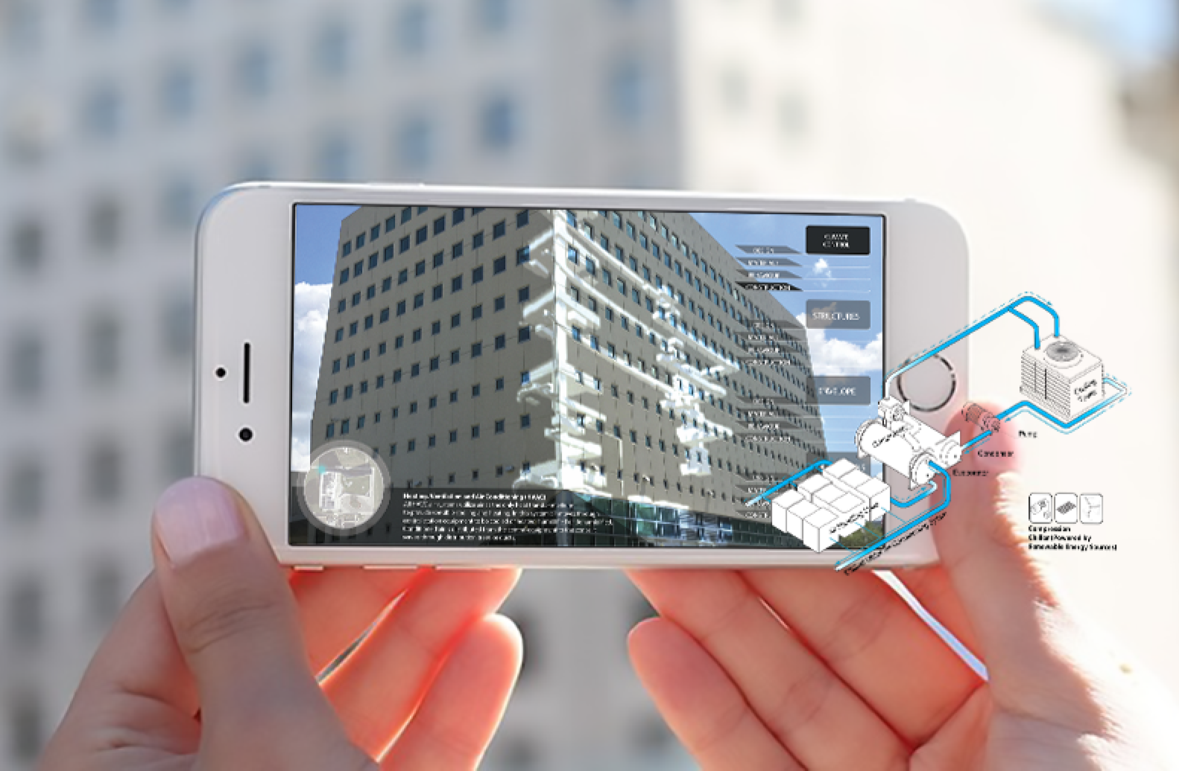
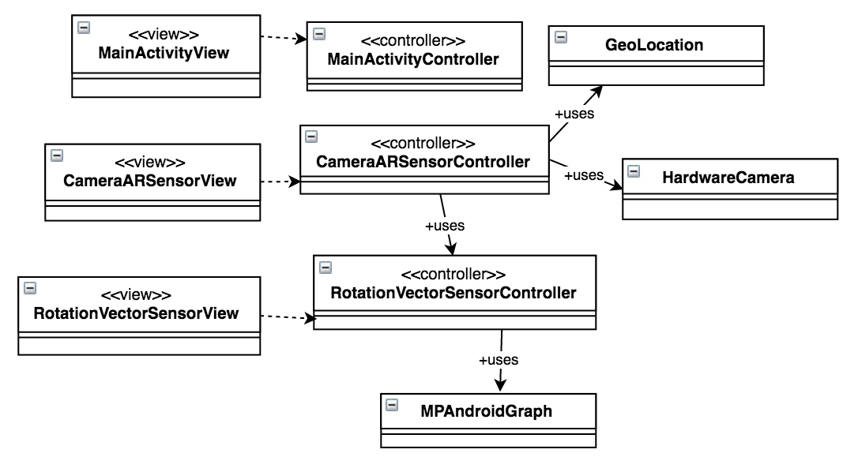

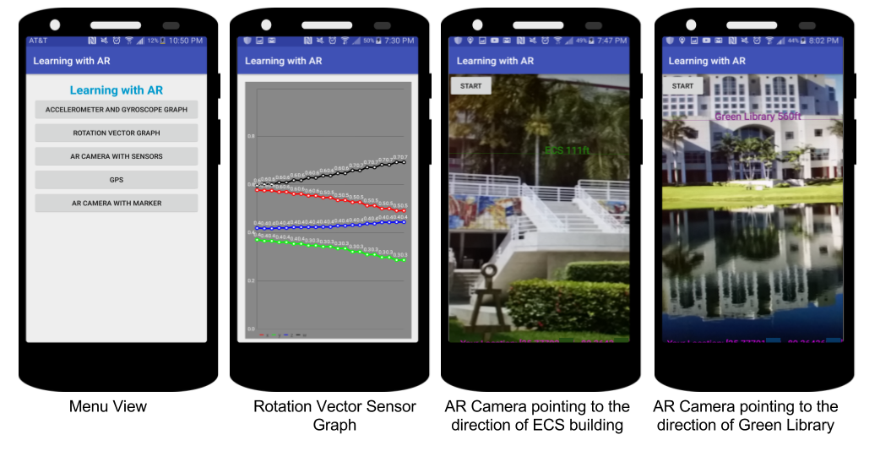


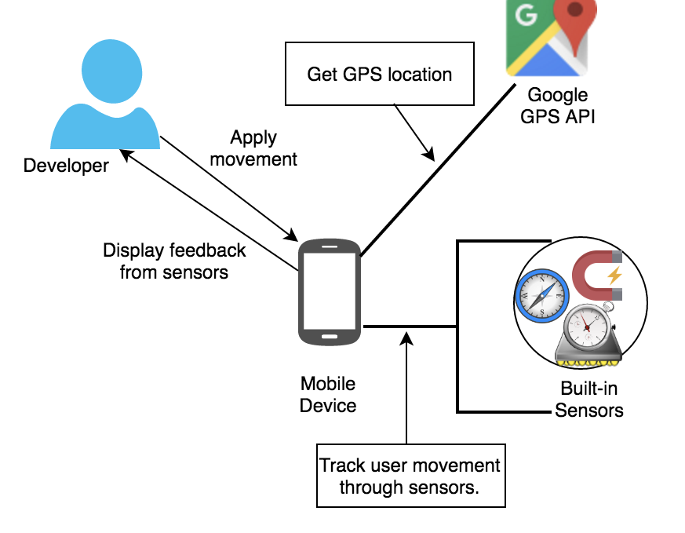
School of Computing & Information Sciences
Advanced Soft. Engineering, 2016, Fall
Learning with Augmented Reality
Student: Maria E. Presa Reyes, Florida International University
Mentor: Mohsen Taheri & Shahin Vassigh & Francisco Ortega &
Lukas Borges, Florida International University
Instructor: Masoud Sadjadi, Florida International University
Problem
Current System
Requirements
Building Information Modeling (BIM) are digital representations of buildings that serve to plan, design, learn and construct infrastructures. Our current focus is facility infrastructures. For those learning about BIM for the first time, it can be difficult to grasp its complexity.
The current system is a Testbed that can be used by a developer to study the power of the Android device and then be able to use it together with Unity for a 3D AR experience. Currently the app can be installed in a handheld device or emulator with Android 5.0 or higher.
Allow developer to analyze change in Rotation Vector Sensor data.
Allow developer to analyze direction of the device’s camera
Allow developer to get current location (longitude and latitude).
Allow developer to measure distance from the building.
Overlay the building information over the Camera View.
Solution
Object Design
Augmented Reality (AR) can make learning this complex concept much easier and fun. The goal of this project is to integrate BIM and AR and make an application that can allow people/students to learn about buildings using their mobile devices. With AR, students can move around physical buildings in the real world and obtain from the app an x-ray vision
Implementation
The system is currently developed for Android devices
Screenshots
Java was the programming language used to develop the app.
System Design
Unity is a game engine used to make interactive 3D experience
Summary
The Learning with AR application is still in its first stages. Rotation vector sensor is a very fast and accurate sensor provided by Android. As part of my contribution, I tried to implement augmented reality using text with the building's name and distance from the user. In the future, computer vision together with this sensor can be used to overlay the 3D model over the building.
Augmented Reality should not only be limited to BIM; many fields can benefit from its power and make the learning experience more fun and engaging.
Verification
The Learning with AR application was verified using unit testing. The app was tested in an Android emulator provided by Android Studio and also in a hardware device with Android installed. With the emulator, we tested the components by feeding it simulated data. Then we tested with real data by using the app in our devices.
Acknowledgement
The material presented in this poster is based upon the work supported by Maria E. Presa Reyes I am thankful to the help that I received from my group member and friend Maryam Aghili
Notes:
1

